Slide 1

SIDDAGANGA INSTITUTE OF TECHNOLOGY
TUMAKURU-572103
(An Autonomous Institute affiliated to VTU)
PERSONALIZED GUI
DEPARTMENT OF INFORMATION SCIENCE AND ENGINEERING
Project Members:
Pallavi Pratik :1SI14IS028
Pawan Kumar Ganjhu :1SI14IS029
Shubham Mishra :1SI14IS046
Guided by:
Mrs. Jagadamba. G.
Assistant Professor
Dept. of ISE

Slide 2
PROBLEM STATEMENT
Organized Home Browser
Personalized GUI for user.
User friendly.
Facilitates work scheduling in a smart way.

Slide 3

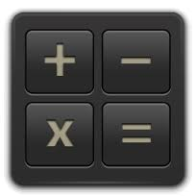


INTRODUCTION
CLOCK
CALCULATOR
CLIPBOARD
CURRENCY CONVERTOR

Slide 4
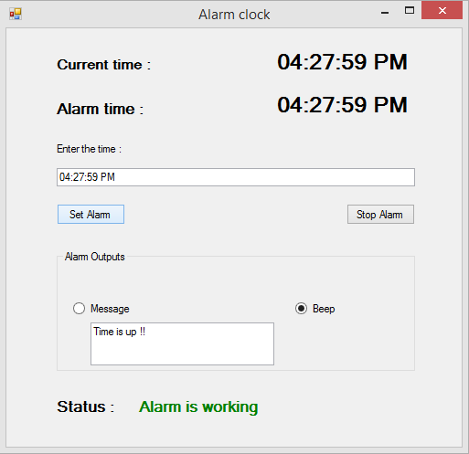
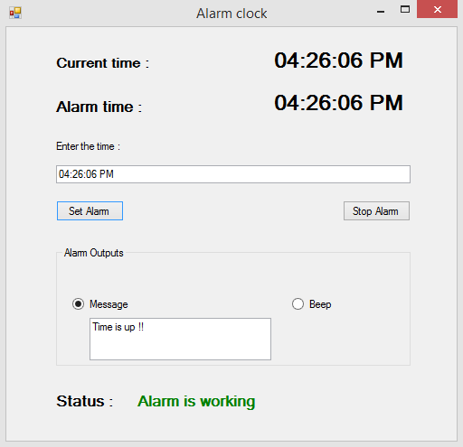
Screenshots of the application

Slide 5
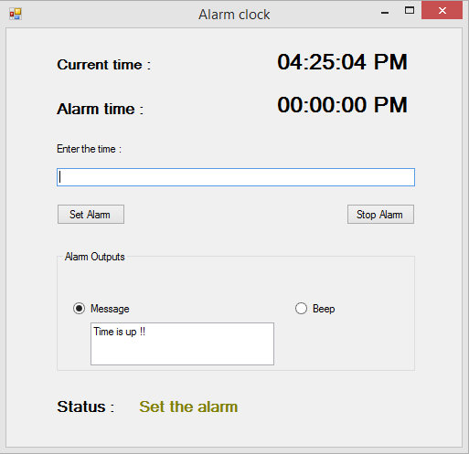
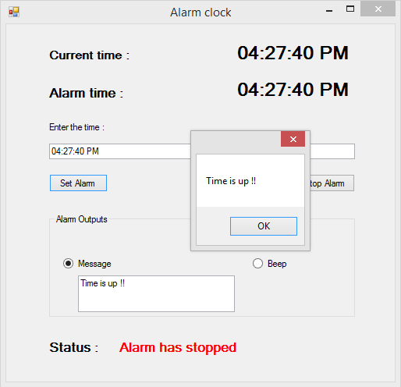

Slide 6
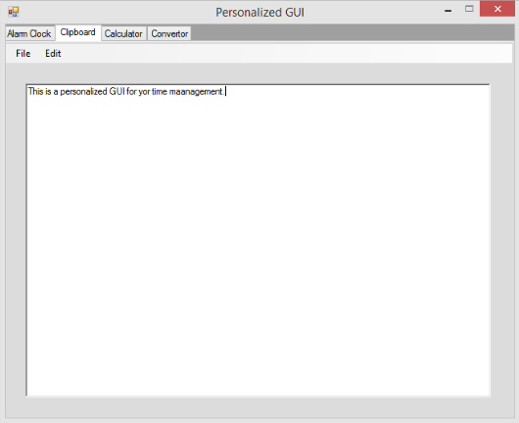
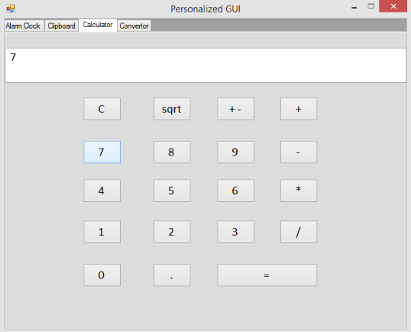

Slide 7
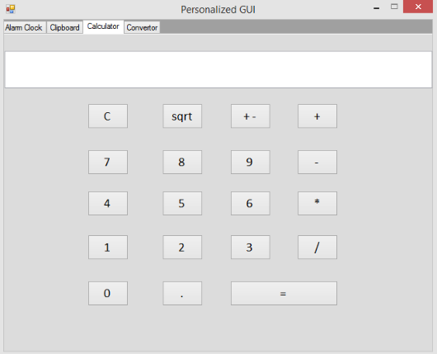
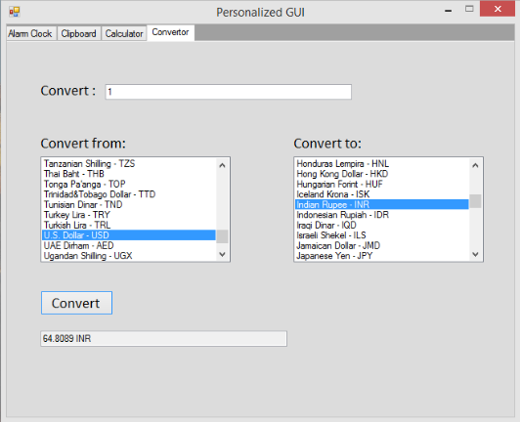

Slide 8
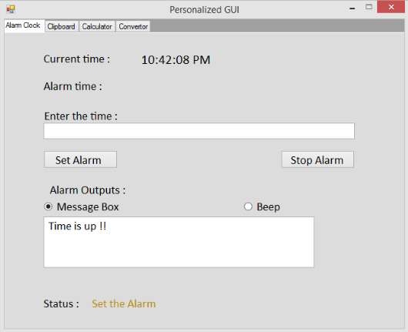
VIEW OF HOMEPAGE

Slide 9
APPLICATION
It is a personalized GUI.
It minimizes the watchdog timer.
Helps in proper time scheduling.
Allows multiple links to be saved together in clipboard.
Calculated result can be saved.
Unit convertor has many physical units to be converted.
It has social benefit as well.

Slide 10
CONCLUSION
Time saver.
User-friendly utility.
Easy to perform unit conversions.
Makes basic calculations handy.
Jot down important points and link from web.
It saves the time of the user.
It minimizes the watchdog timer.
It reduces the energy loss.
Helps in proper time scheduling.
Allows multiple links to be saved together in clipboard.
Currency convertor gives equivalent amount in another currency.

Slide 11
THANK YOU…

